Slide 1
MVGR’S SOCIAL MEDIA
Guided by
Mr. M. Chandra Sekhar
By,
A. Mounika Tulasi Mani Prasanna - 14331A0501
CH. Tarun Kumar - 14331A0532
A. Bhanu Siva Prasad - 14331A0509
B. Pushpanjali - 14331A0523

Slide 2
INTRODUCTION
“MVGR SOCIAL MEDIA” is a Mobile Application which is used only for the students of MVGR. In this application students are authenticated with their email Id’s and the password. The main reason behind this application is that the students can know more information about the college and what’s going on – upcoming events, any cultural programs, the student activities, sports, and about the examination complete details.

Slide 3
MVGR conducts many events like Flash mobs, KITAB, Blood donation campaign, NSS, Guiding villagers on the name of “LEAD MVGR” and many more.
So to the updates, time, place, when, where it is going to happen, the complete details can be updated in this media. This media can be one of the best examples like FACEBOOK and INSTAGRAM.
Every department conducts many events – like for example CSE conducts workshops, Civil conducts Sports, ECE conducts Essay Writing competitions, and many other departments have many more ideas.
Instead of going and announcing or using of notice boards may not reach everyone. So for this purpose students can post the events what the department conducts in this media. Students are also supposed to post the workshops updates or PPT updates which will be conducted in other colleges So, this is an application which brings entire MVGR STUDENTS INTO ONE COMMUNITY.

Slide 4
PROBLEM DEFINTION
The Well-Structured and friendly passage of information in the way of today’s techno-development methodologies is put forwarded for the small community like “MVGR College of Engineering” and the way of solution for the question of “HOW” came into forward with title of “MVGR’S SOCIAL MEDIA”.
MVGR Social Media app is not only to communicate or interact with the other students in the college but, this is also one efficient way for college promotion through students. This site is used to socialize with your friends but also, represents a huge pool of information from day to day living.
Finally this application bring the different blocks of information under single community in very friendly manner.

Slide 5
TECHNOLOGIES
Ionic (mobile app framework) Ionic is a complete open-source SDK for hybrid mobile app development. The more recent releases, known as Ionic 2 or simply "Ionic", are built on Angular. Ionic provides tools and services for developing hybrid mobile apps using Web technologies like CSS, HTML5, and Sass.
Firebase helps you develop high-quality apps and grow your business. Each product works independently, and they work even better together.
Firebase Cloud Messaging. Formerly known as Google Cloud Messaging (GCM), Firebase Cloud Messaging (FCM) is a cross-platform solution for messages and notifications for Android, IOS, and web applications, which currently can be used at no cost.

Slide 6
Your First Hybrid Mobile App with Ionic Framework Goal In this lab we will guide you how to create a hybrid mobile application with Ionic 2 Framework. Here we are going to create a sample login screen and then how to navigate from one screen to another screen Pre-Requisites
Node JS and NPM installed
Cordova
Ionic Framework
Text editor (Visual Studio Code is preferable)
Technologies Involved
Ionic 2 Framework
Cordova
HTML / CSS / JS
Typescript
Angular 2/4

Slide 7
USE CASE DIAGRAM
A use case diagram depiction of the interactions among the elements of a system. A use case is a methodology used in system analysis to identify, clarify, and organize system requirements. Use case diagrams are employed in UML( unified modeling language), a standard notation for the modeling of real-world objects and systems.
A use case diagram contains four components. The boundary, which defines the system of interest in relation to the world around it.
The actors, usually individuals involved with the system defined according to their roles.
The use cases, which are the specific roles played by the actors within and around the system.

Slide 8
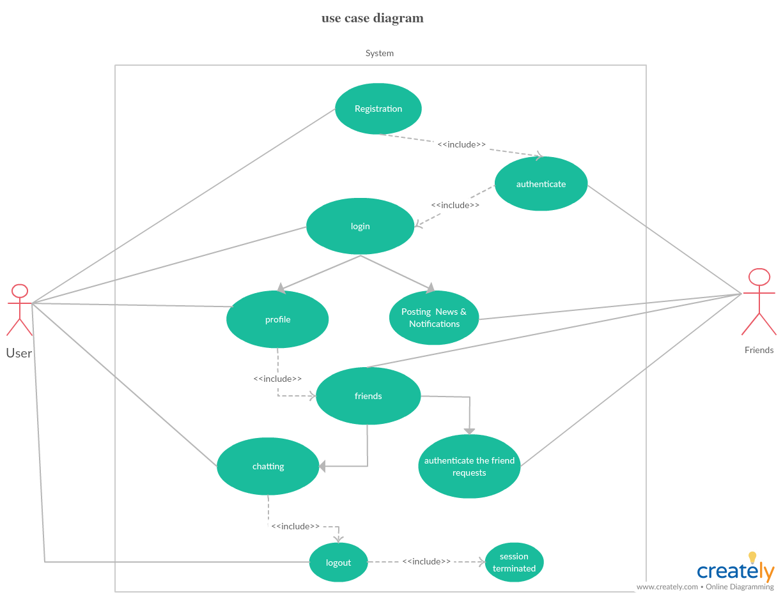

Slide 9
ENTITY RELATIONSHIP DIAGRAM
The entity relationship model is a high level data model. It is based on a perception of a real world that consists of collection of basic objects, called entities, and of relationship among the objects.
Entity: An entity is an object that has its existence in the real world. It includes all those “things” about which data is collected. Entities are represented in rectangles.
Entity Set: It is a set of entities of the same type that share the same properties, or attributes.
Attributes: Attributes are units that describe the characteristics or properties of entities. In a database, entities are represented by tables and attributes by columns.

Slide 10
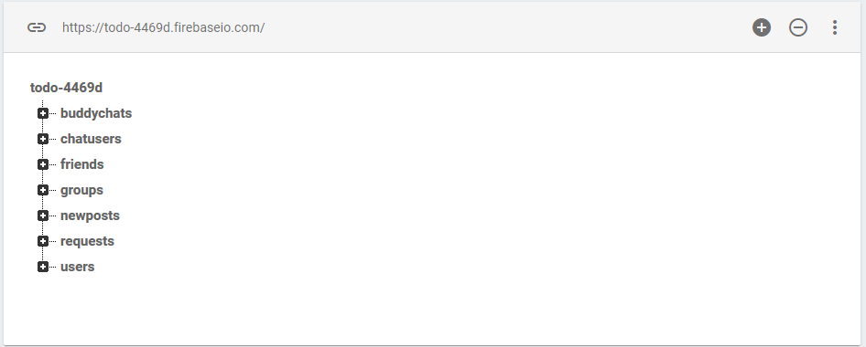

Slide 11
OVERVIEW
Basically focusing on the using of API of weather concept for knowing the details.
In this application students are authenticated with their email Id’s and the password.
In this application students can get their learning sources, notification on events done in our college.
Each and every students can post the events what the department conducts in this media.
It eliminates the purpose of going and announcing or using of notice boards may not reach everyone.

Slide 12
Receive posts that is been updated.
Sending posts to the users (i.e., post the updates).
Can send the messages to the individuals belonging to any department by using the concept of chatting and group chatting.
Post the videos, images, posters and many more.
they can check the weather details of entered city and state.
Users can make phone calls directly from our app.
They can also play music through our app with in the local files.

Slide 13
THANK YOU

